Slide 1

Intellectual Property
Prof. Koliya pulasinghe

Slide 2


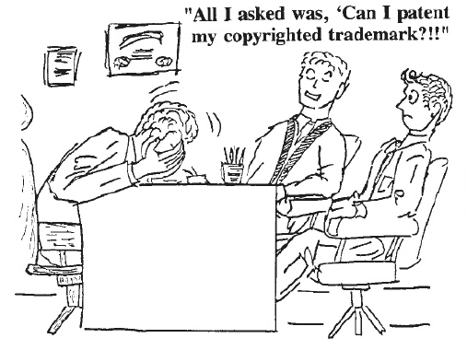




Slide 3
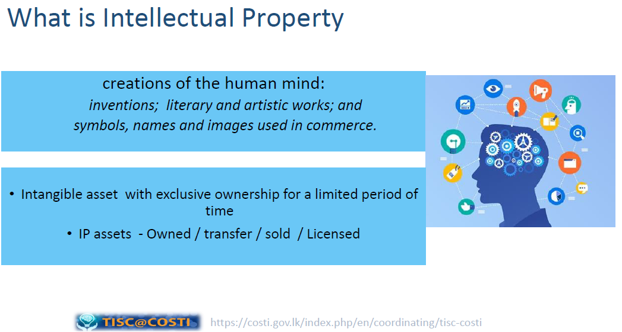

Slide 4
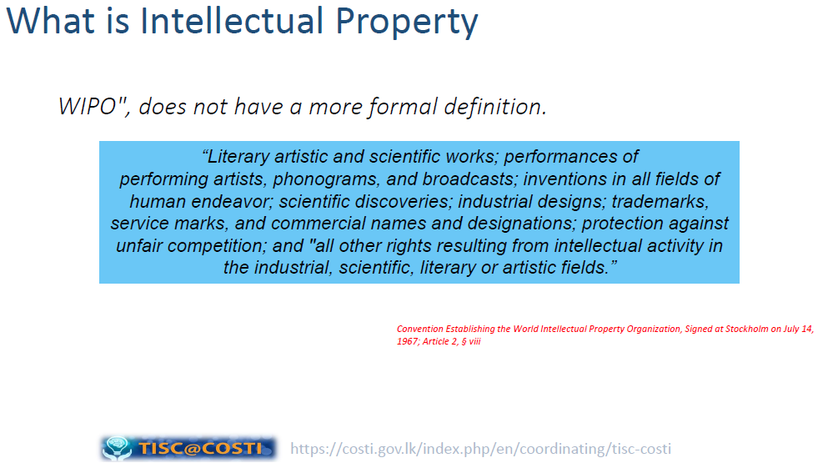

Slide 5
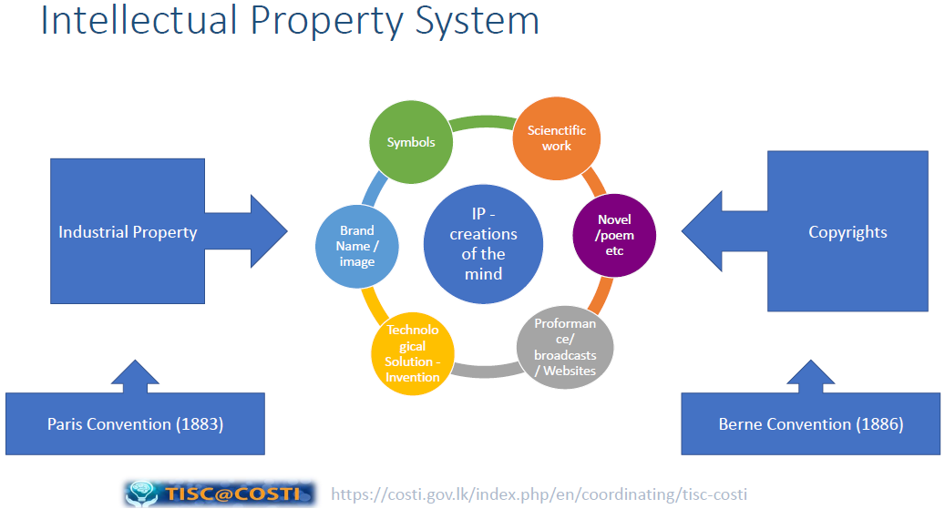

Slide 6
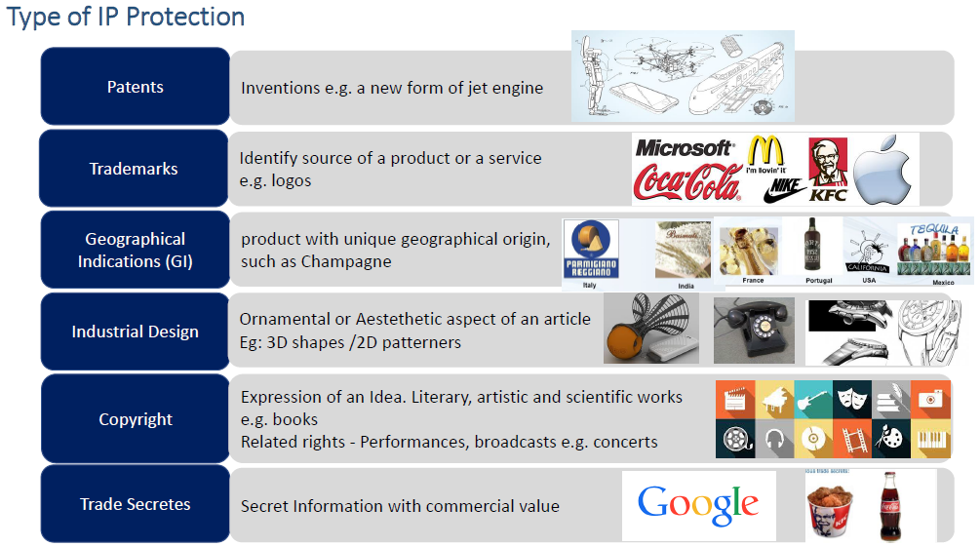

Slide 7
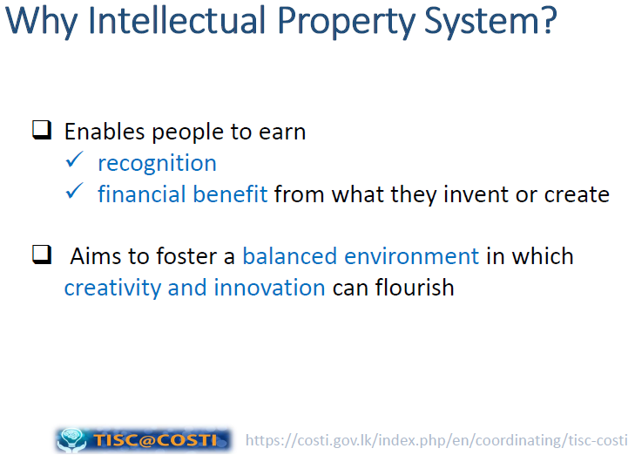

Slide 8
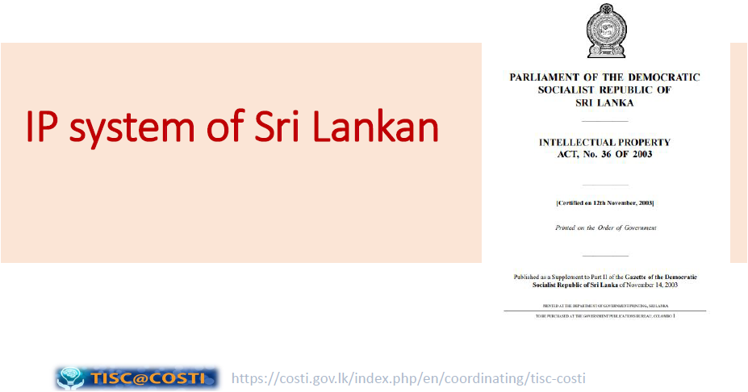


Slide 9
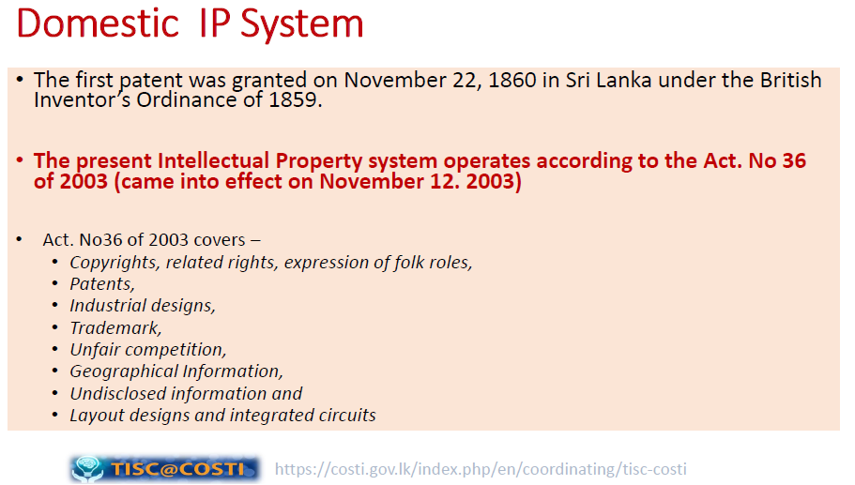

Slide 10
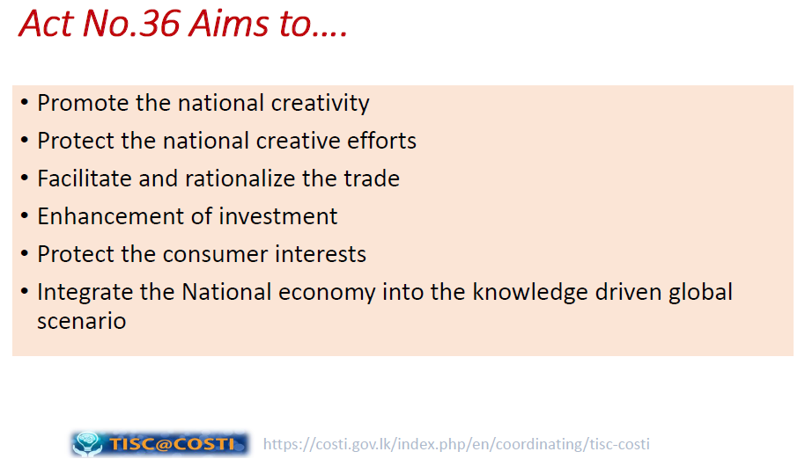

Slide 11
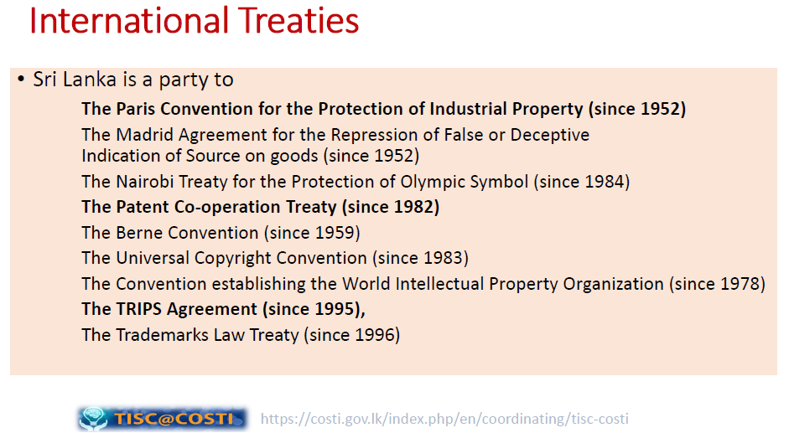

Slide 12
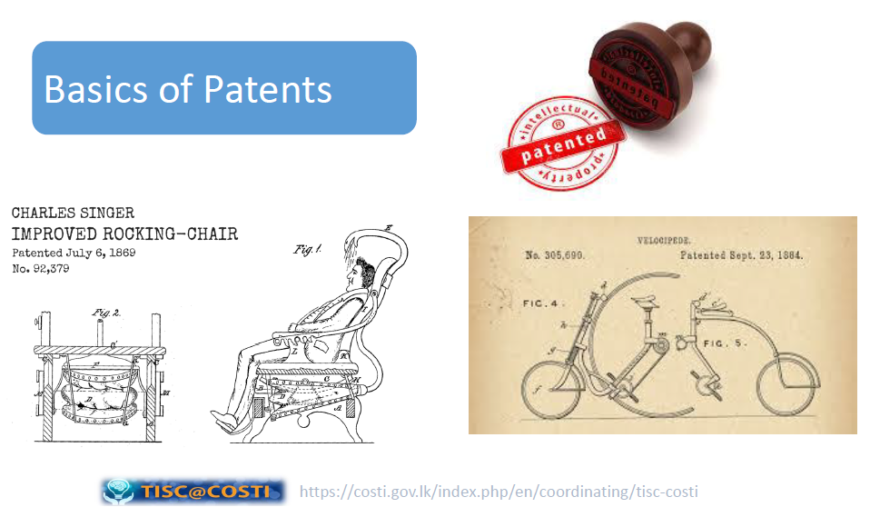

Slide 13
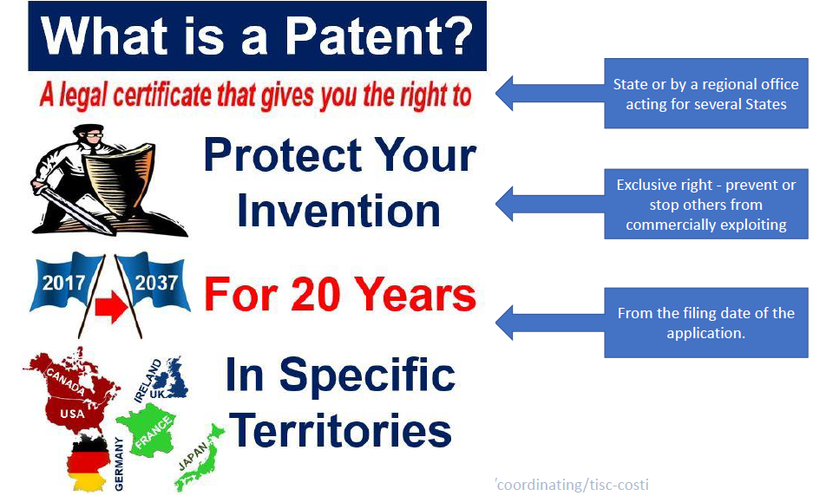

Slide 14
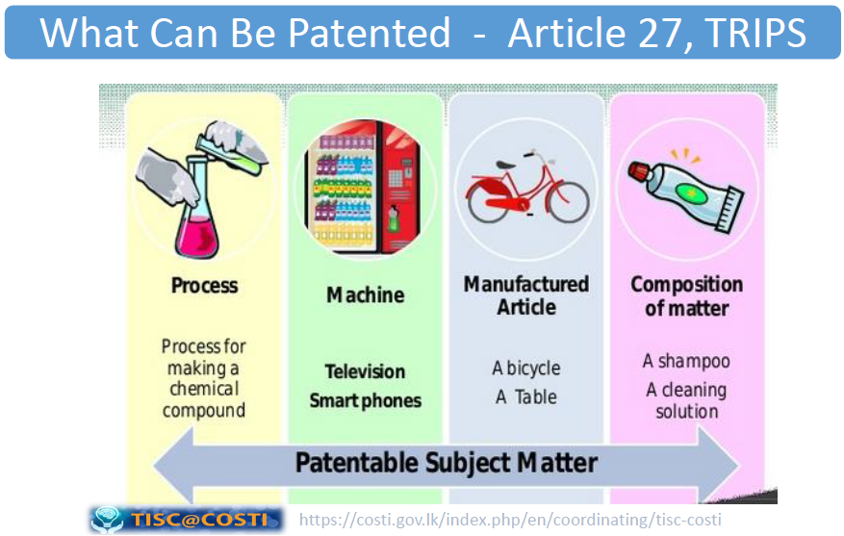

Slide 15
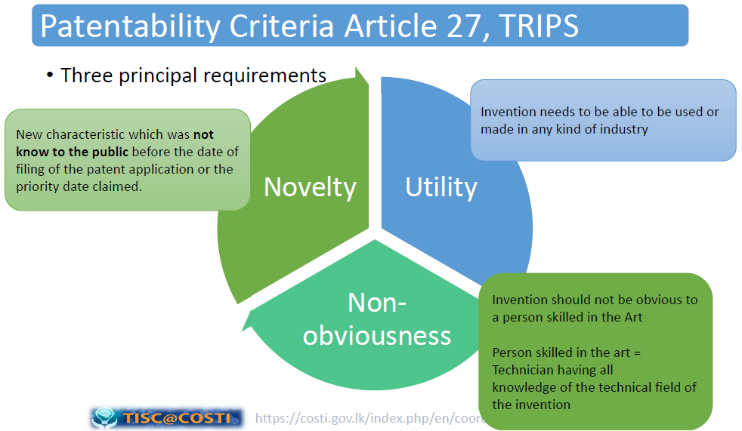

Slide 16
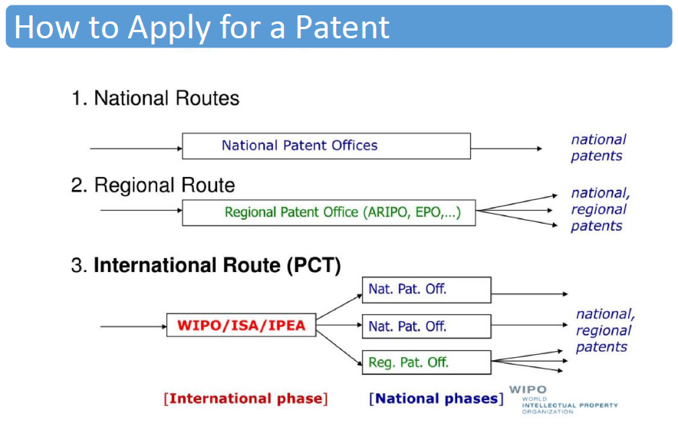

Slide 17
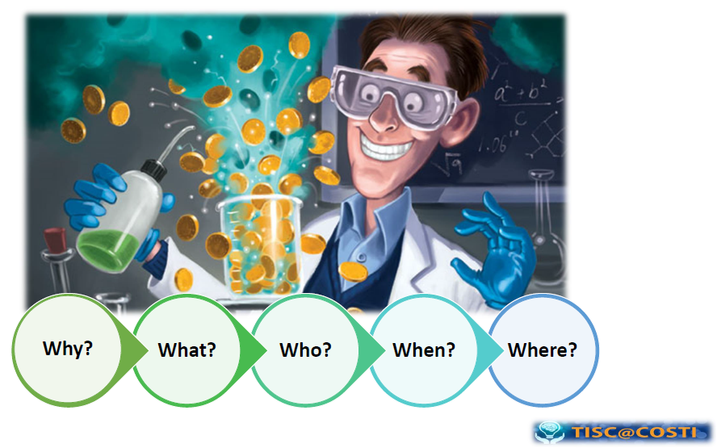

Slide 18
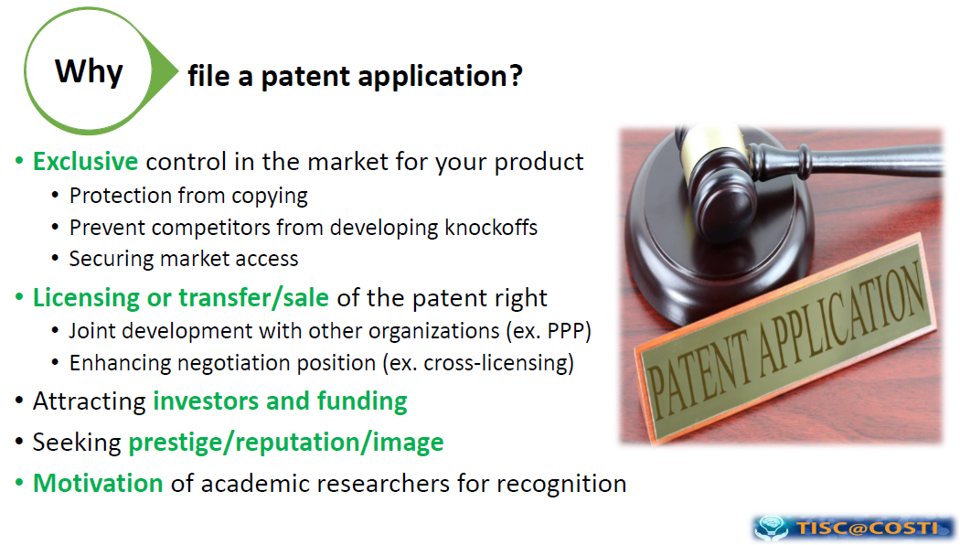

Slide 19
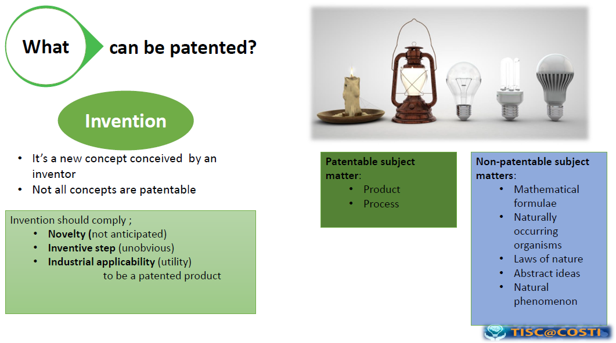

Slide 20
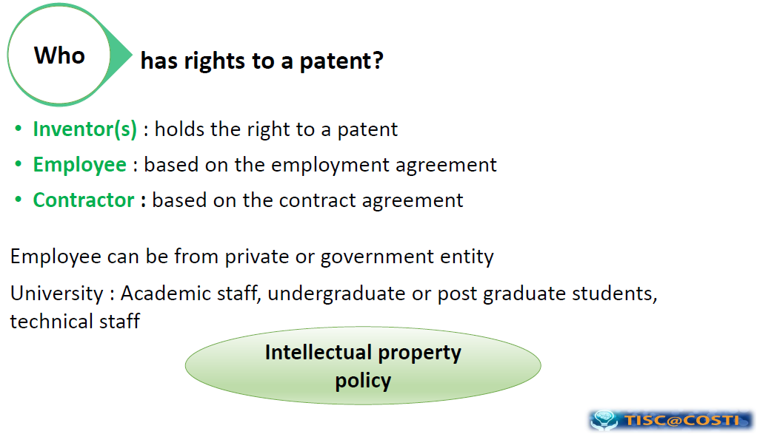

Slide 21
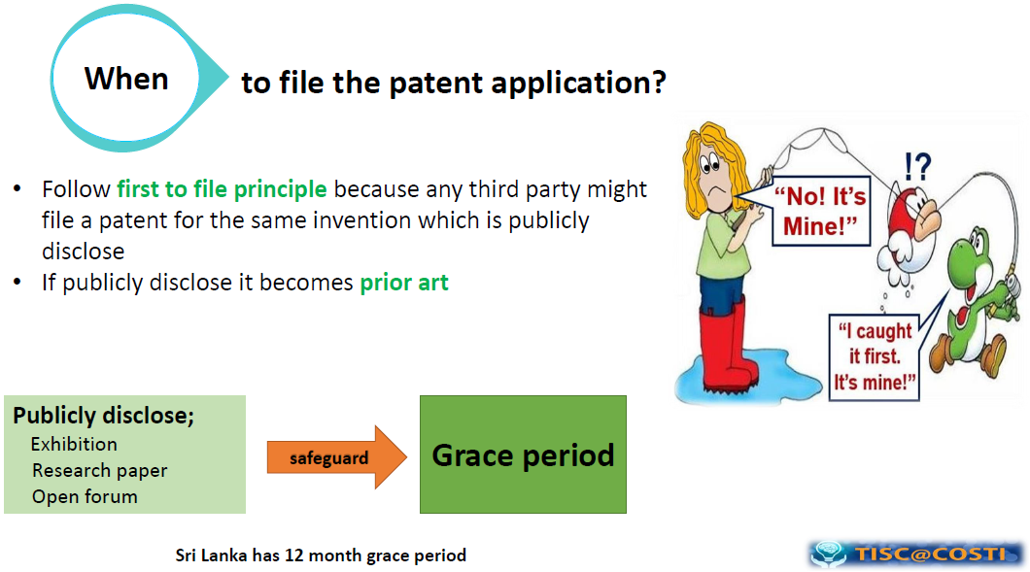

Slide 22
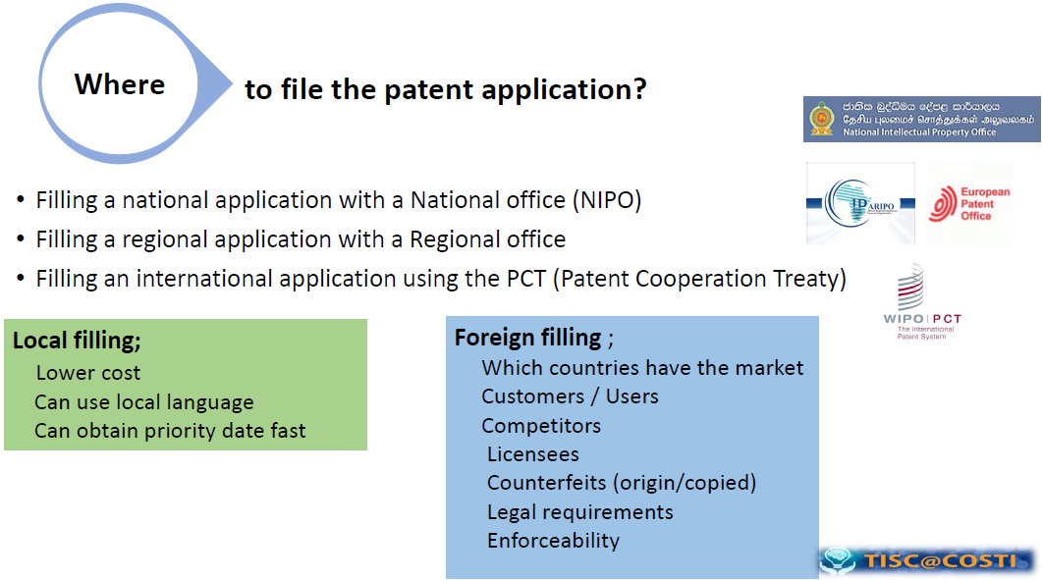

Slide 23
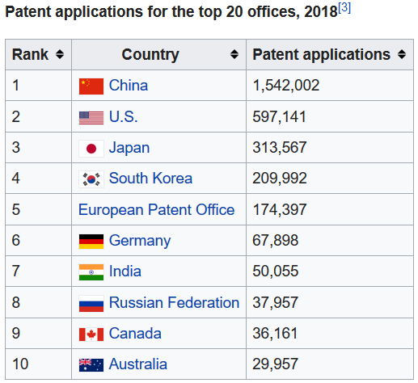

Slide 24
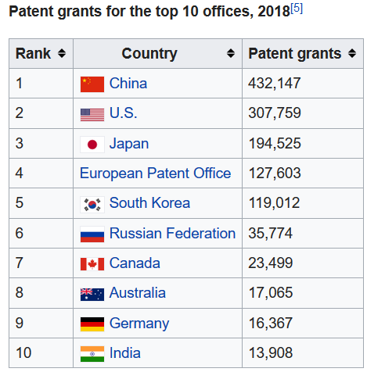

Slide 25
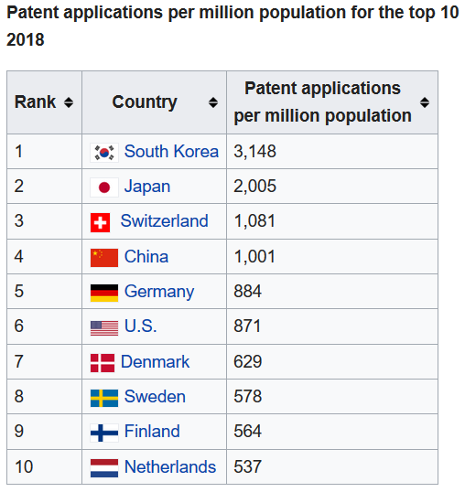

Slide 26
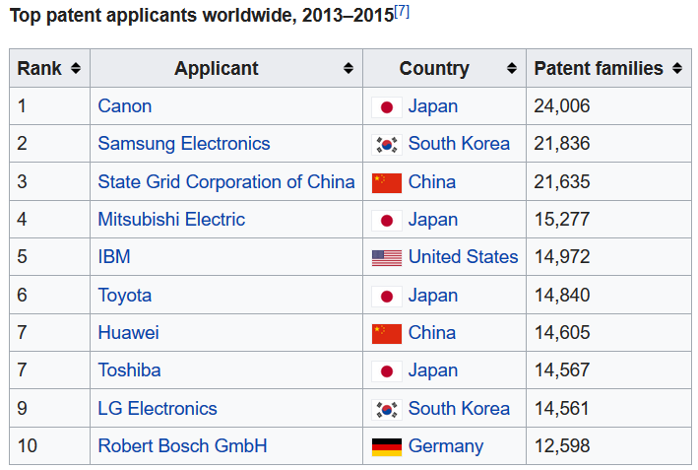

Slide 27
Licensing of an IP
Licence is a permission that an IP owner grant to another person to use the IP on agreed terms and conditions, while he continues to retain ownership of the IP
Licensing creates an income source
It establishes a legal framework for transfer of technology to a wider group of researchers and engineers
Creates market presence for the technology or trademark

Slide 28
Software Piracy
Software piracy is the unauthorized and illegal duplication of copyrighted software.
Covers in Sri Lanka Intellectual Property Act, No. 36 of2003
In general, you do not have the right to copy, loan, rent, or in any way distribute the software, unless otherwise specified in the license.
The commercial value of pirated software is $19 billion in North America and Western Europe and has reached $27.3 billion in the rest of the world.
According to the 2018 Global Software Survey, 37% of software installed on personal computers is unlicensed software

Slide 29
Software Piracy
Five major types of software piracy could be classified:
Soft-lifting
Client-Server Overuse
Internet Piracy
Hard-Disk Loading
Software Counterfeiting

Slide 30
Fair Use
Copyright law protects certain exclusive rights of copyright holders.
However, copyright law does allow limited copying, distribution, and display of copyrighted works without the author's permission, under certain conditions known as "fair use“.

Slide 31
Fair Use
Here are the four standards:
The purpose and character of the use.
The nature of the copyrighted work.
The amount and substantiality of the portion used in relation to the copyrighted work as a whole
The effect of use on the potential market for or value of the work.

Slide 32
Open-Source Software
Source code to software ought to be freely distributed
Encourage to examine and improve other’s code
New version of software appear much more frequently
Eliminate tension between obeying copyright law and helping others
Anyone can make money by providing support, those who provide best support would be rewarded
Ex: Apache web servers, Linux OS

Slide 33
Protect your Intellectual Property
Register the Appropriate IP Protection
The strongest protection comes from registering your work. By doing so, you put your claim into the public view, discouraging many (but not all) people from using your work without permission.
Trademark registration
Fill a trademark application on its main brand and apply for registration

Slide 34
Protect your Intellectual Property
A patent or provisional patent
Fill a provisional patent application and apply for the patent to protect your creation.
Registering your copyright
Protect trade secrets
Establish policies and procedures to demonstrate ownership

Slide 35
Assignment
Collect the latest statistics related to Countries/Organizations and their patents as in slides 23 to 26. Write an essay on “Why rich countries are rich?” (Max. 300 words)
Write an essay on “How Sri Lankan universities can make Sri Lanka a wealthy nation” (Max. 300 words)
Write a reflective journal on a situation that you feel sad about being a Sri Lankan. Write what you, as a Sri Lankan can do to prevent that for future generations.
Submit your assignment as a PDF on or before midnight 11th May, 2021.

